Slide 1
The Internet of THINGS (IoT)
How devices, data, networks and the cloud are changing our world Bret Stateham Microsoft Technical Evangelist BretStateham.com

Slide 2
Overview
“IoE”, “IoT”, “M2M” What?
Devices & “Things”
Networks & Protocols
Cloud Computing & Big Data

Slide 3
What is the “internet of things”
Internet of things
Syllabification (Inter•net of things) noun
A proposed development of the Internet in which everyday objects have network connectivity, allowing them to send and receive data: “If one thing can prevent the Internet of things from transforming the way we live and work, it will be a breakdown in security.”
Source: Oxford Dictionary, yep, it’s really in the Oxford Dictionary. It got added at the end of August, 2013

Slide 4
Cisco’s Definition
“Bringing together people, process, data and things to make networked connections more relevant and valuable than ever before”
Source: Cisco

Slide 5
A phrase coined
Kevin Ashton first used the phrase “Internet of Things” in a 1999 presentation on RFID & the Supply Chain at Proctor and Gamble
Later, in 2009, he wrote about what he intended the phrase to mean in an article he wrote for RFID Journal entitled: “That ‘Internet of Things’ Thing: In the real world, things matter more than ideas”
Source: Kevin Ashton, “That ‘Internet of Things’ Thing: In the real world, things matter more than ideas”, RFID Journal, June 2009

Slide 6
“Today computers—and, therefore, the Internet—are almost wholly dependent on human beings for information. Nearly all of the roughly 50 petabytes (a petabyte is 1,024 terabytes) of data available on the Internet were first captured and created by human beings—by typing, pressing a record button, taking a digital picture or scanning a bar code…”
Source: Kevin Ashton, “That ‘Internet of Things’ Thing: In the real world, things matter more than ideas”, RFID Journal, June 2009

Slide 7
“If we had computers that knew everything there was to know about things—using data they gathered without any help from us—we would be able to track and count everything, and greatly reduce waste, loss and cost. We would know when things needed replacing, repairing or recalling, and whether they were fresh or past their best.”
Source: Kevin Ashton, “That ‘Internet of Things’ Thing: In the real world, things matter more than ideas”, RFID Journal, June 2009

Slide 8
“We need to empower computers with their own means of gathering information, so they can see, hear and smell the world for themselves, in all its random glory. RFID and sensor technology enable computers to observe, identify and understand the world—without the limitations of human-entered data.”
Source: Kevin Ashton, “That ‘Internet of Things’ Thing: In the real world, things matter more than ideas”, RFID Journal, June 2009

Slide 9
A rose by any other name
Pervasive Computing
Ubiquitous Computing (ubicomp)
Internet of Things (IoT)
Internet of Everything (IoE)
Machine to Machine (M2M)
Industrial Internet

Slide 10
CONNECTED “THINGS” vs people
2013 - Est. 10 Billion CONNECTED Devices
vs. Est. 7.14 Billion People World Population
Est. 50 Billion connected devices in 2020
More connected devices than connected people
2003
2008
2015
2020
Source: Cisco & Internet World Stats

Slide 11
Want more stats?
There is as much as $14.4 Trillion of value at stake for the global private sector over the next decade
Of the $1.2 Trillion at stake for 2013, over 47% ($500 Billion) is being left on the table
99.4% of physical objects are still unconnected! Or Only 10 Billion of the total 1.5 Trillion things are connected
There are approximately 200 connectible things per person in the world today! Wow!
Source: Cisco

Slide 12
enablers
Moore’s Law
Low Power Wireless
Low Power CPUs
Standards
Cloud Computing
Cloud Data Storage
Crowdfunding
Toolsets & Libraries
Rapid Prototyping
Notes:
Moore’s Law (amount of computing power / sq in.)
Low Bandwidth / Low Power Wireless Networking
Lower Power CPUs (Intel, ARM)
Cloud Computing
Cloud Data Storage
Big Data – Hadoop
Convenient prototyping (Arduino, Netduino, 3D Printing)
Standards (MQTT / OMA-DM)
Toolsets (m2m.eclipse.org)

Slide 13
Devices & things
Let’s see some cool stuff!

Slide 14
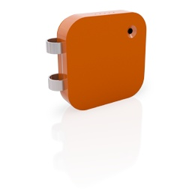

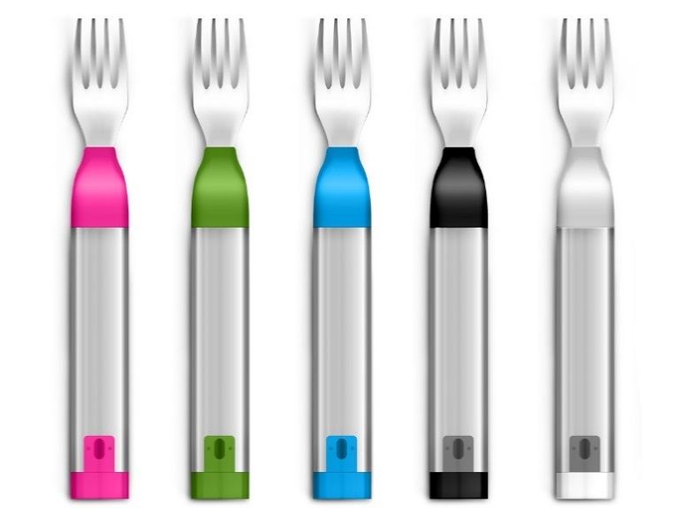
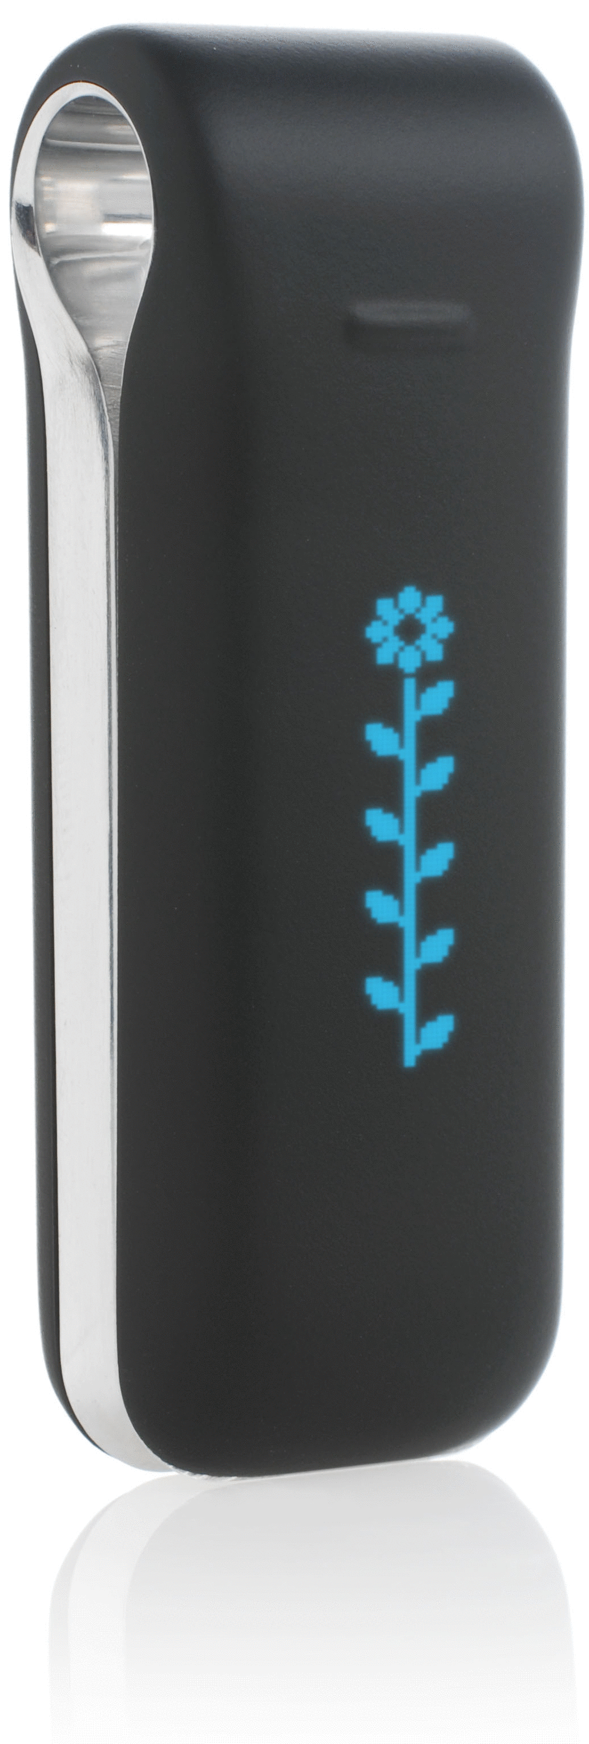


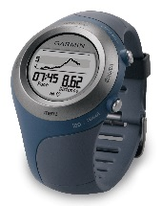





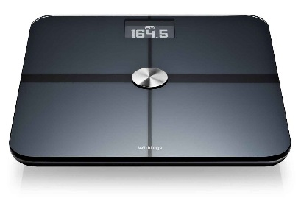

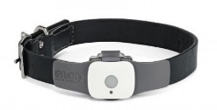

The Quantified self

Slide 15
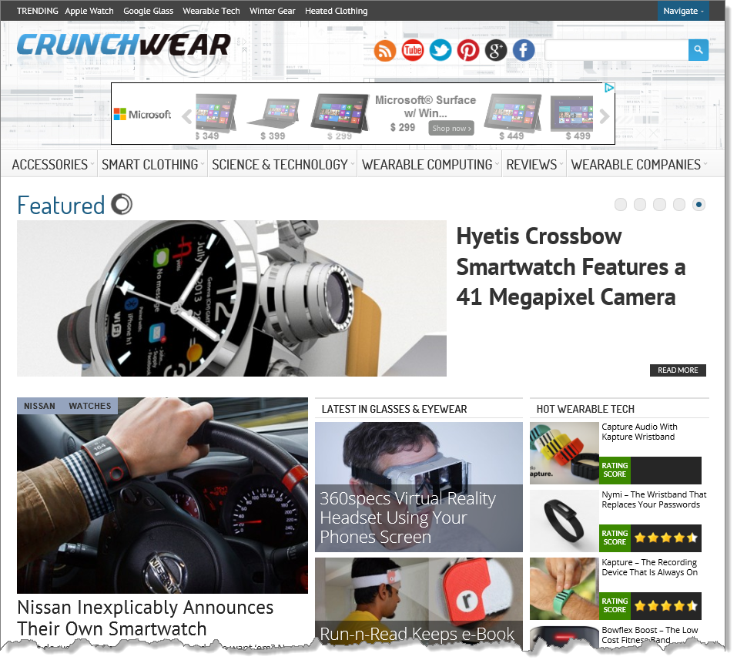

Slide 16

Building a better mousetrap
Source: “TEDx Warwick – Andy Stanford-Clark – Innovation Begins at Home”

Slide 17

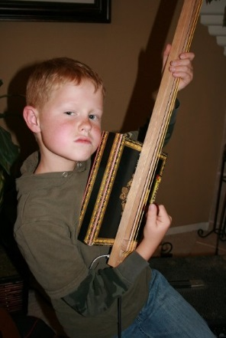
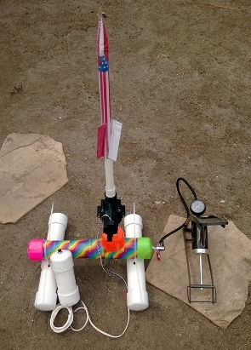
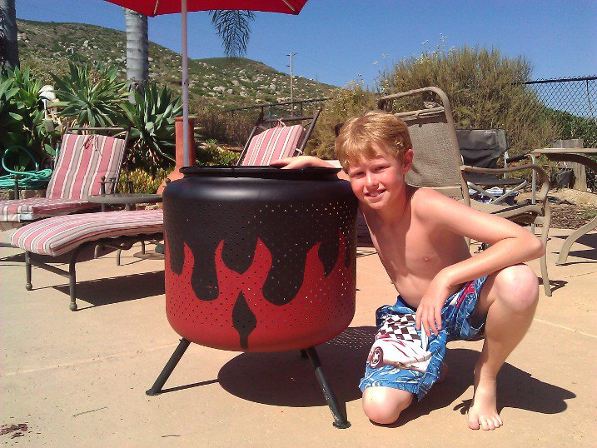


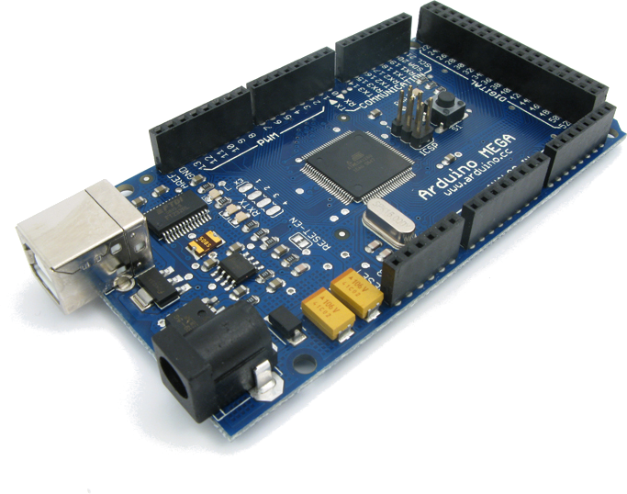
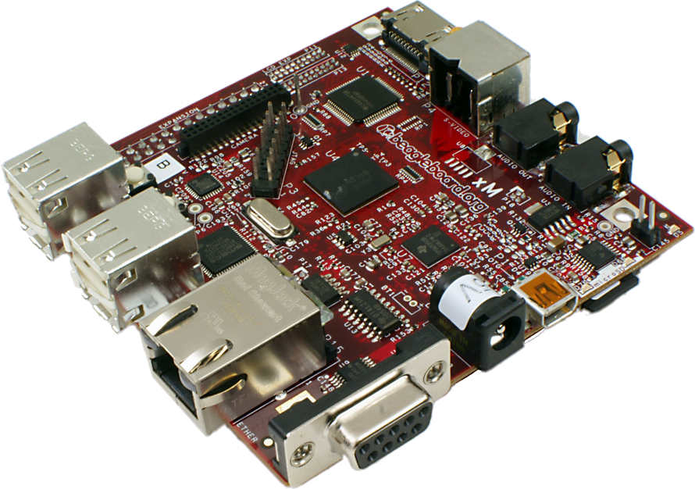

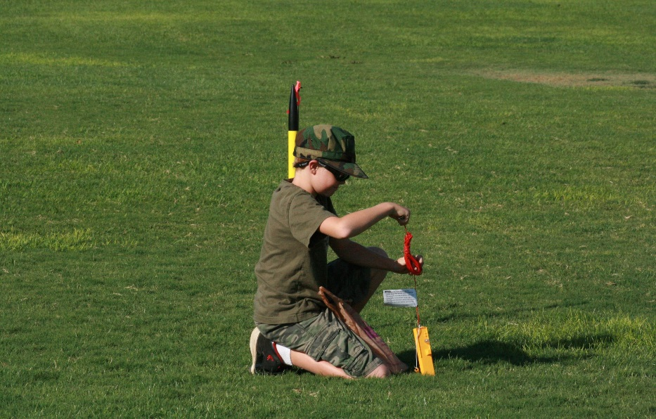
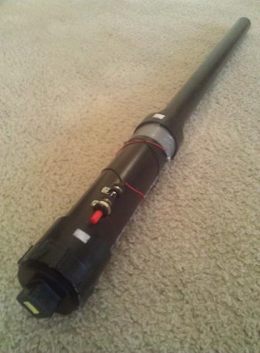
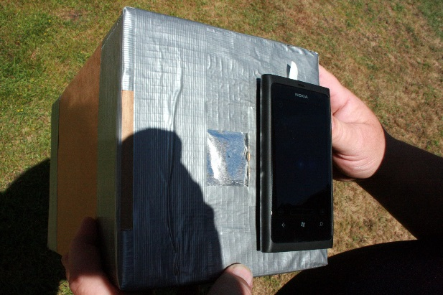




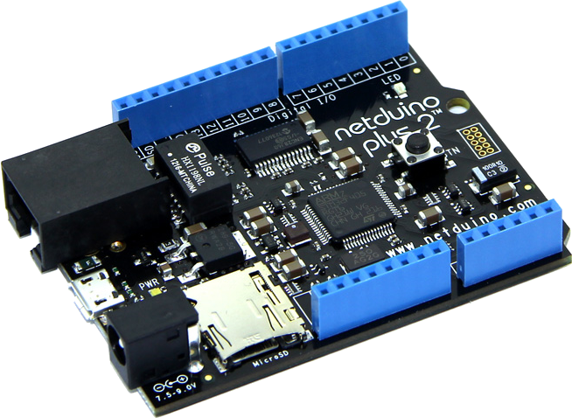

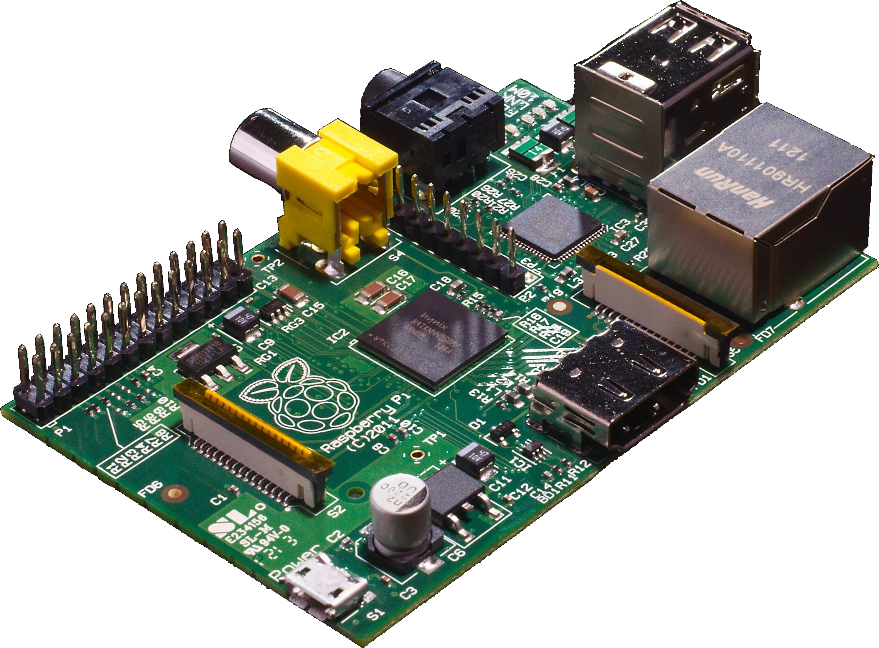
THE MAKER REVOLUTION

Slide 18
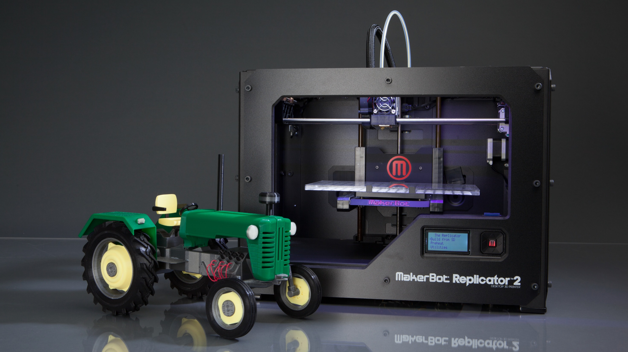
3D printing & milling

Slide 19
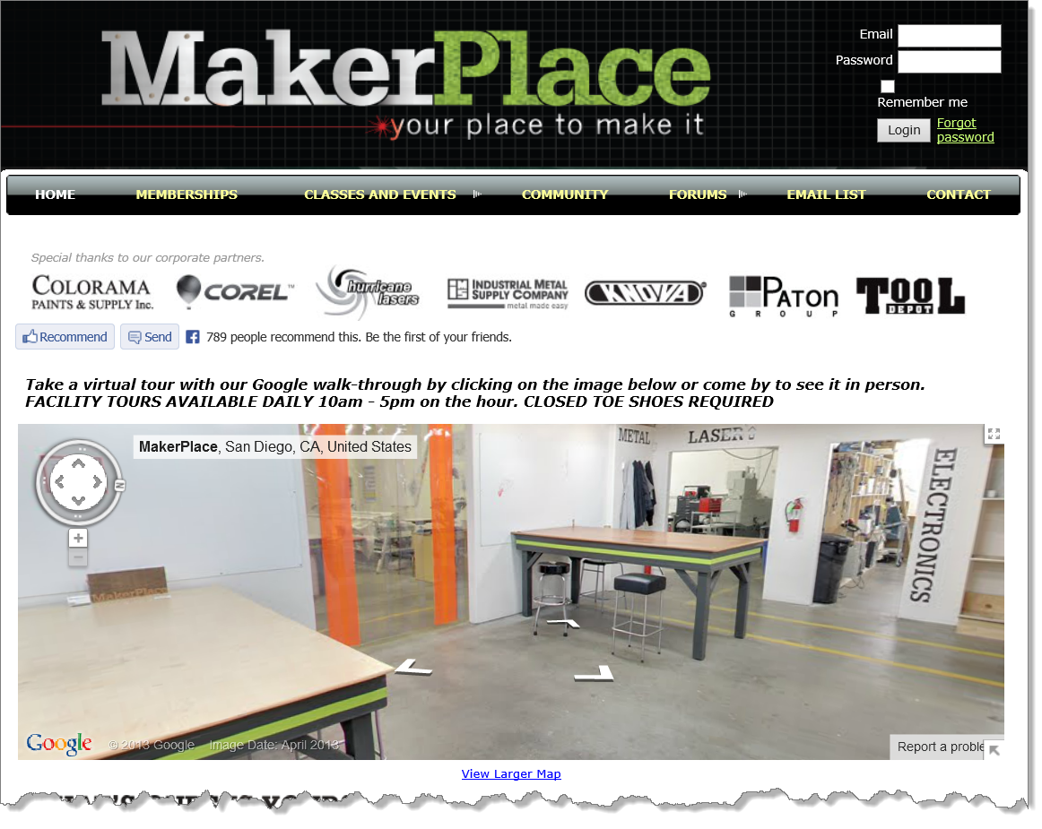
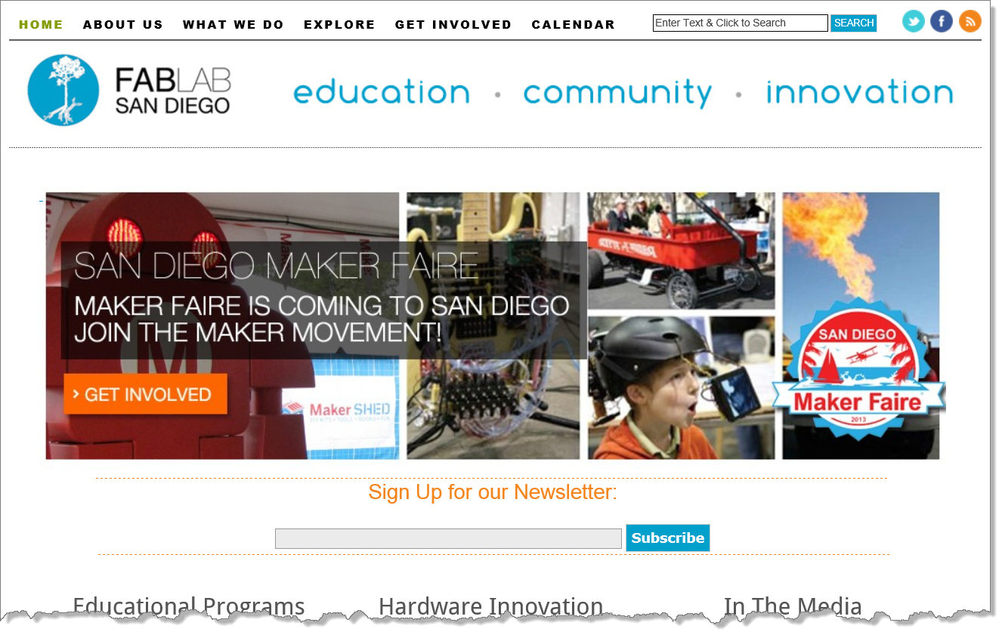
Maker spaces, places and FAIRES
Not just for adults! Many of these places make significant efforts to educate kids from elementary school age and up. Often this is made possible by STEM (or STEAM) grants.

Slide 20





Crowdfunding
Since starting in 2009….
48,000 Projects
4,800,000 People
$777,000,000 Pledged
44% Projects Reached Goal
$274,391,721 Collected in 2012
Source: Kickstarter

Slide 21
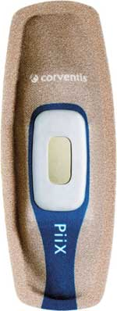

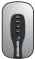
Medical applications
Wireless cardiovascular solutions
Source: Corventis

Slide 22

Smart pills (ok, pill bottle caps)
Check out GlowCaps

Slide 23
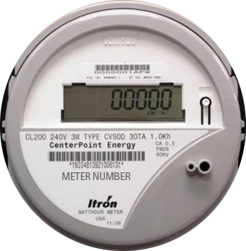
Smart grid

Slide 24
Other domains
Automated Transportation Smart Cars
Smart Transit
Smart Grid
Smart Home
Predictive Maintenance
Agriculture Smart Cows & Smart Corn
Military
Smart City

Slide 25
How do they communicate?
What are the networking protocols and standards that make this work?

Slide 26
Connection paths
Home automation,
Self Tracking, etc.
People
P2M
Machines (things)
P2P
M2M
Social Networking
Email, Skype, etc.
Smart Grid, Smart Home, etc…

Slide 27
Ipv4 (32bit) address space
4,294,967,295 or 4.3 Billion Addresses

Slide 28
Ipv6 (128bit) address space
Remember, we’re only talking about trillions of devices!
and billions of people!
Undecillion
Decillion
Nonillion
Octillion
Septillion
Sextillion
Quintillion
Quadrillion
Trillion
Billion
Million
Thousand
Hundred
340,282,366,920,938,463,463,374,607,431,768,211,456 or 340.3 Undecillion Addresses

Slide 29




wireless, SWARMS, and CLOUDS
Want to know more? Check out Cisco’s Flavio Bonomi’s “Emerging Trends in Wireless in the Era of IoT”

Slide 30


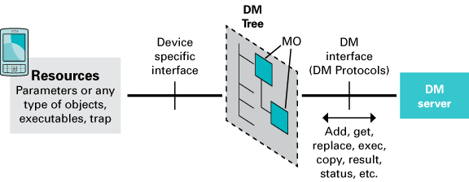
standards
Created by Dr. Andy Stanford-Clark of IBM and Arlen Nipper of Arcom in 1999
The OMA Device Management (DM) Working Group specifies protocols and mechanisms to achieve the management of mobile devices, services access and software on connected devices.
Undergoing the OASIS standardization process
Message Queuing Telemetry Transport (MQTT) is a lightweight broker-based publish/subscribe
messaging protocol designed to be open, simple, lightweight and easy to implement.
Where the network is expensive, has low bandwidth or is unreliable
When run on an embedded device with limited processor or memory resources
http://openmobilealliance.org/about-oma/work-program/device-management/

Slide 31
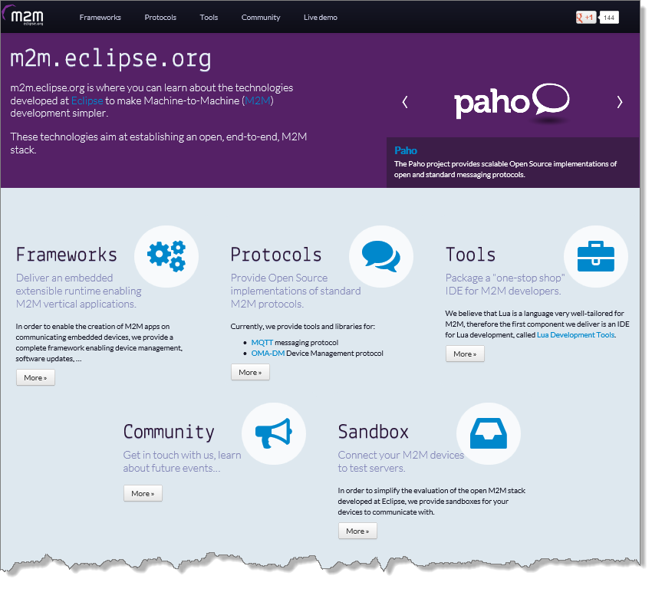
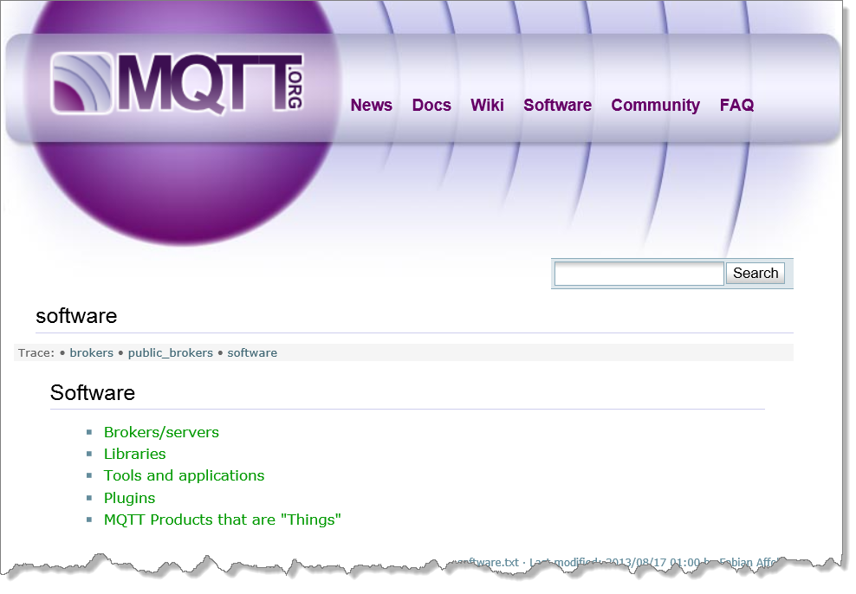
Libraries and tools

Slide 32
That sounds like a lot of data
How are we going to store, process, and analyze it all?

Slide 33
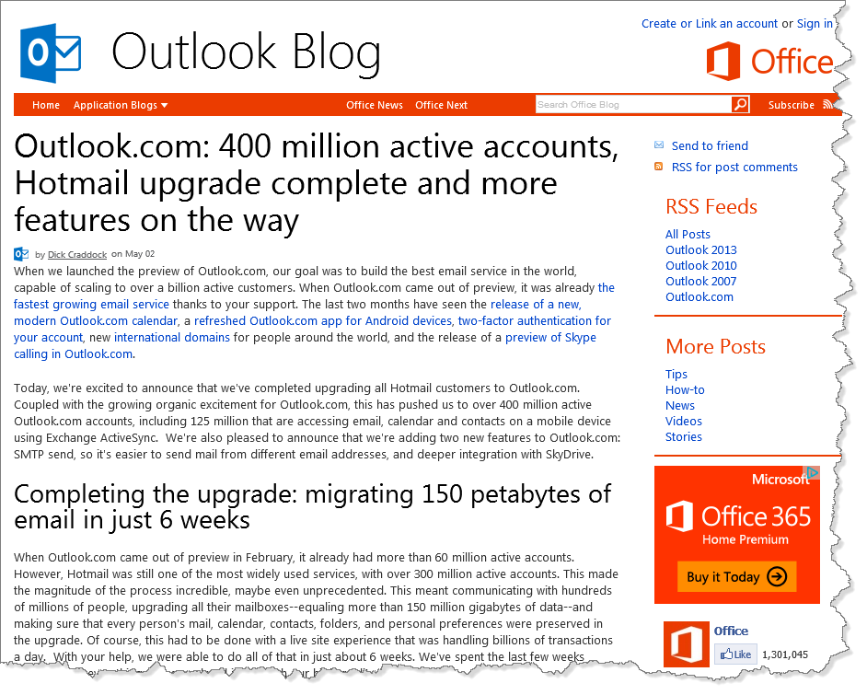
How much data is out there? HARD TO SAY!
Outlook.com has over 400 million
active accounts
Over 150 Petabytes of data stored!
Source: Outlook Blog

Slide 34
Giga, tera, exa, peta, zetta , yotta
16 Hours
1.8 Years
1913 Years
1.9 Million Years
2 Billion Years
That’s a “yotta” music!
Cisco predicts that annual internet traffic volume will hit 1.3 Zettabytes by 2016 (source)
If a one minute mp3 music file is about 1.1MB then…

Slide 35

OUCH. THAT HURTS MY BRAIN
Image courtesy of Jack Germsheid

Slide 36
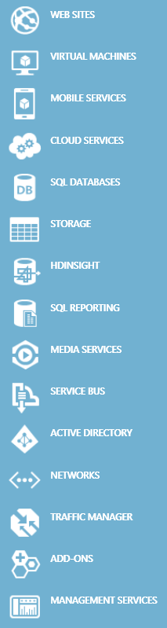
Cloud computing
Compute Services
The current state of cloud computing revolves mainly around the running of Virtual Machines (IaaS) or applications (PaaS) in the cloud vendor’s data centers.
Application Services
In addition to running your code, cloud services can store your files & data, help authenticate your users, route data between your networks, stream your videos, and much more.

Slide 37


CLOUD OVERVIEW
Traditional Software
Infrastructure (as a service)
Platform (as a service)
Software (as a service)
Applications
Applications
Applications
Applications
You manage
Data
Data
Data
Data
Runtime
You manage
Runtime
Runtime
Runtime
Middleware
Middleware
Middleware
Middleware
You manage
O/S
O/S
O/S
O/S
Managed by vendor
Virtualization
Virtualization
Virtualization
Virtualization
Servers
Servers
Servers
Servers
Managed by vendor
Managed by vendor
Storage
Storage
Storage
Storage
Networking
Networking
Networking
Networking

Slide 38
Cloud storage
Azure Blob Storage Amazon S3
Azure SQL Database Amazon RDS
Files
Azure Table Storage MongoDB, etc
Azure Queues Azure Service Bus
NoSQL
Queues

Slide 39
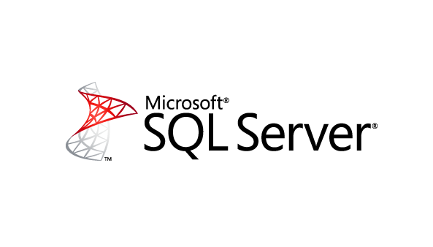








Big data – Volume, velocity, variety
mapreduce

Slide 40
mapreduce
Hadoop / Azure HDInsight
REDUCE TO COUNT
16
REDUCE TO COUNT
12
MAP UNITS BY COLOR
OUTPUT
REDUCE TO COUNT
12
REDUCE TO COUNT
09

Slide 41
REVIEW
“IoE”, “IoT”, “M2M” What?
Devices & “Things”
Networks & Protocols
Cloud Computing & Big Data

